Slide 1

BLOCKCHAIN
NGUYỄN MINH LỘC
NGUYỄN TUẤN ĐẠT
DƯƠNG ĐÌNH TRUNG

Slide 2

01
ORIGIN
CONTENTS
02
DEVELOPMENT HISTORY
03
APPLICATIONS
04
POTENTIALS

Slide 3
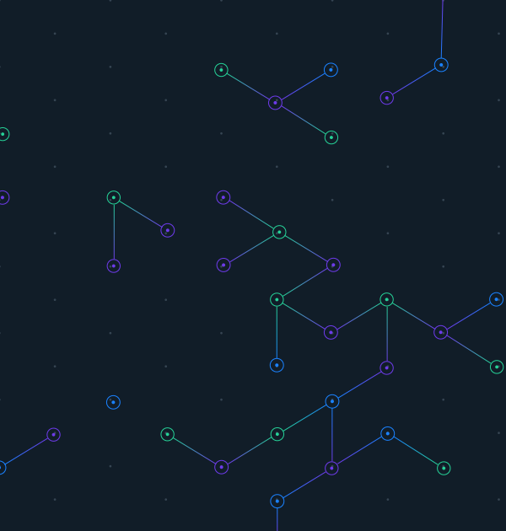

01
ORIGIN

Slide 4
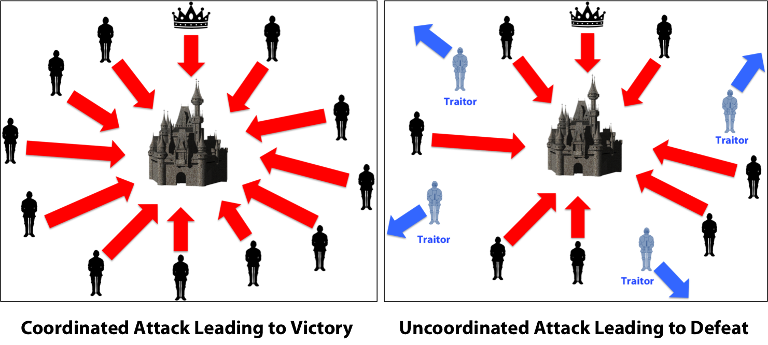


ORIGIN
BYZANTIME GENERALS
It’s derived from the problem of Byzantine Generals

Slide 5
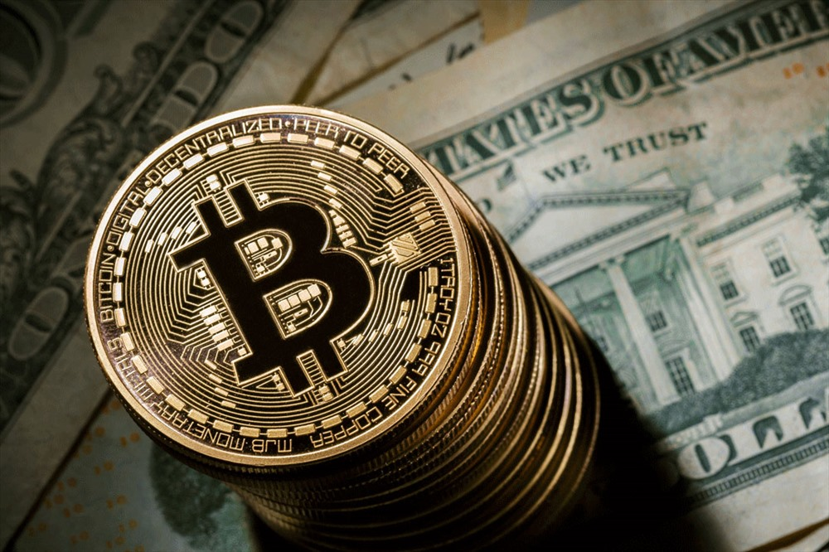
02
DEVELOPMENT
HISTORY

Slide 6
DEVELOPMENT HISTORY
BIT GOLD
BLOCK CHAIN
1982
1998
2008
2009
2015
CRYPTOGRAPHIC SIGNATURES
A PEER-TO PEER ELECTRONIC
CASH SYSTEM
ETHEREUM BLOCK CHAIN

Slide 7

03
APPLICATIONS

Slide 8
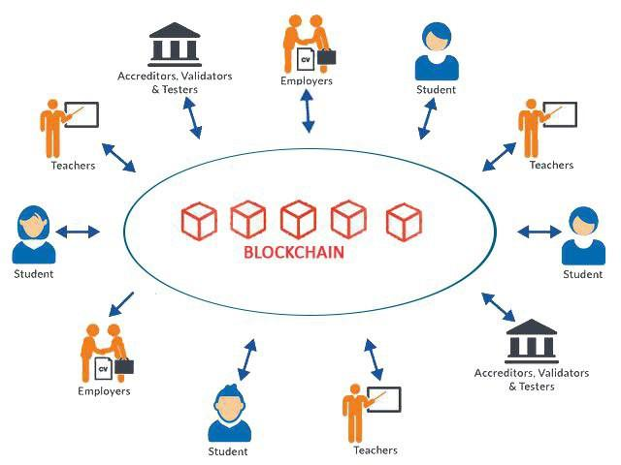
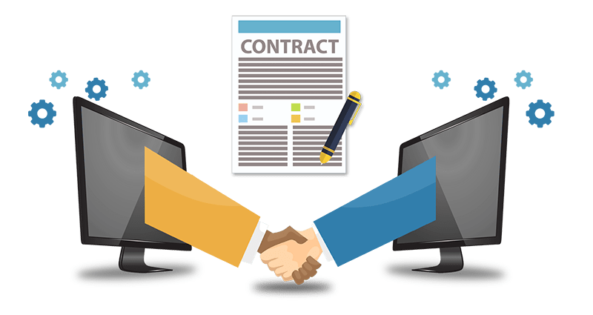

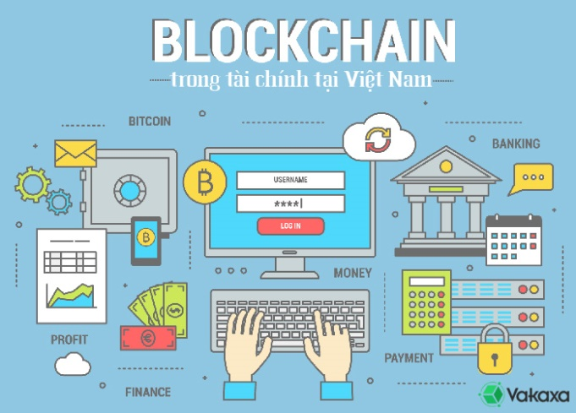
APPLICATIONS
EDUCATION
ECOMMERCE
HEALTHCARE
FINANCE

Slide 9

04
POTENTIALS

Slide 10
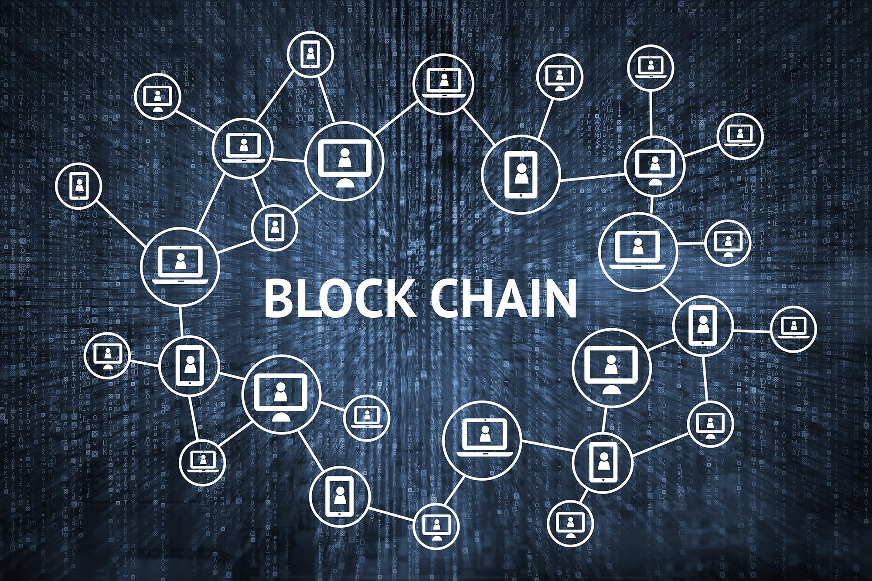
POTENTIALS
NO DETAIL ORIENTATION
NEGATIVE PURPOSES
MANY
EMPLOYMENTS

Slide 11
REFRENCES
Bryan, Derek. “What is Blockchain Technology? A Step-by-Step Guide For Beginners”. Technology Futurist, 2019,
https://blockgeeks.com/guides/what-is-blockchain-technology/, Accessed May 5, 2019.
Blockchain la gi. Kien thuc ve cong nghe chuoi khoi”. Bitcoin Vietnam News, 2018,
https://bitcoinvietnamnews.com/blockchain-la-gi, Accessed May 5, 2019
“Blockchain la gi? Ung dung cua cong nghe chuoi khoi Blockchain”, Blog Tien Ao, 2018, https://blogtienao.com/blockchain-la-gi/, Accessed May 5, 2019
Maria Redka, “Future of the Blockchain Technology: Use Cases, Risks and Challenges”, MLSDev, 2018,
https://mlsdev.com/blog/the-future-of-the-blockchain-technology-use-cases-geographical-expansion-potential-risks-and-challenges,Accessed May 5, 2019

Slide 12


THANK YOU
FOR
YOUR LISTENING

